Slide 1
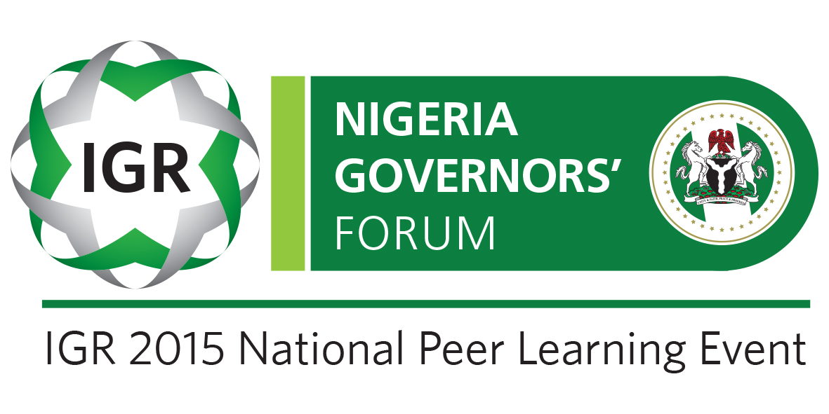
Mon 16 Nov 2015

Slide 2
International Case Studies of IGR Reform and Practical Measures for States’ consideration at the IGR National Peer Learning Event 16/17 November 2015 Abuja, Nigeria Dr Mark Abani, ACTI, ACIMAN, FNIM, FICA Tax Consultant

Slide 3
IGR: What is it and why it is important.
Generally the term Internally Generated Revenue (IGR) is used in a number of ways but in the context of discussing State finances it refers to the revenue sources generated solely by the State and its local Governments.
So IGR refers to the income within the State or LGA that is used to finance State/LGA programmes and services.
Given that the Federal allocation has dropped significantly following the crash in oil prices in 2015, it is clear that until these IGR sources are harnessed, understood and maximized, the State Governments will not be able to achieve their plans.
Taxes, levies and related IGR must be considered within the framework of the extant Legislation and Policy
Nigeria’s National Tax Policy
The Nigerian Constitution 1999
States and the Law covering Taxes and Levies they can charge.

Slide 4
IGR: The Legislation and Rules.
Nigeria’s National Tax Policy
At National Tax Policy level, taxes are defined as “pecuniary burden laid upon individuals or properties to support government expenditure” . It groups them into 4 Broad categories; on individuals, companies, by transaction and on assets. In a little more details:
On individuals – Personal Income Tax (PIT) and Development levy
On companies – Corporate Income Tax (CIT) etc. (not relevant to States)
On Transaction – VAT – collected by Federal but 85% is sent back to States; Capital Gains Tax (CGT)
On Assets – Property tax, etc..
The Nigerian Constitution 1999
The Constitution of the Federal Republic of Nigeria, 1999, Cap. C23, Laws of the Federation of Nigeria provides general taxing powers for the federation as well as its federating units.
In summary, Legislation is Federal but collection is on concurrent list, while Local Government is legislated by State.
States and the Laws covering Taxes and Levies they can charge.

Slide 5
International Experiences
An overview
Though many countries in the world generate their revenue at national and local level, very few have the structure in Nigeria where there are three levels of collection and two levels of legislation. The closest to this structure is found in Brazil and India. A third is partially true in Canada.
Similar Separation in powers
In both Brazil and India there are laws that charge the Federal level with the primary collection of taxes and levies especially of international and interstate financial activities, while States have powers on concurrent legislation to both charge and collect a number of taxes and levies. In turn the States legislate for the collection of IGR at the Local levels.

Slide 6
Brazil
Brazil has one of the most complex tax systems in the world with tax burdens equal to 36% of GDP.
In Brazil tax is collected at three (3) levels and all three have constitutional rights to create their own taxes. Taxes are broadly categorised as follows:
Union or Federal Government – Corporation Tax (CT), Personal Income Tax (PIT)
States – Value Added Tax (ICMS)
Municipalities Local Services tax Property and real estate
The bias is for Indirect tax not direct tax and the Indirect tax is complex and at subnational level. Attempt to simplify VAT have had a recent set-back

Slide 7
India
India has a well-developed tax structure with clearly demarcated authority between Central and State Governments and local bodies.
The Central Government levies taxes on income (except tax on agricultural income, which the State Governments can levy as well), customs duties, central excise and service tax.
The state governments levy Value Added Tax (VAT), (Sales tax in States where VAT is not yet in force), stamp duty, State Excise, land revenue (Mineral rights), local consumption taxes, Road vehicles tax, Personal Income Tax on professions, trades, callings and employment and Capital taxes.
Local bodies are empowered to levy tax on properties and charge for provision of services and utilities like water supply, drainage etc.

Slide 8
India
The Indian tax structure has led to a number of problems:
• Multiplicity of taxes:.
• Dominance of Indirect taxes:
• Ad-hocism:
• Complexity and corruption:
• Imbalance in the tax system.
In last 10-25 years, the Indian taxation system has undergone tremendous reforms. The tax rates have been rationalized and tax laws have been simplified resulting in better compliance, ease of tax payment and better enforcement.
The process of rationalization of tax administration is still ongoing in India especially in the area of VAT and GST, though planned changes recently failed to get approval.

Slide 9
Canada
Taxation in Canada is a shared responsibility between the federal government and the various provincial and territorial legislatures.
Under the Constitution Act, 1867, taxation powers are vested in the Parliament of Canada for ‘The raising of Money by any Mode or System of Taxation.’
The provincial legislatures have a more restricted authority for: ‘Direct Taxation within the Province for the raising of a Revenue for Provincial Purposes and Shop, Saloon, Tavern, Auctioneer, and other Licences in order to the raising of a Revenue for Provincial, Local, or Municipal Purposes.
In turn, the provincial legislatures have authorized municipal councils to levy specific types of direct tax, such as property tax.
There is a Federal tax authority which enters into agreements with provinces to collect some taxes on their behalf and remit the same.

Slide 10
IGR Revenue improvement internationally
Tax reform for the improvement of revenue all have common features to address the issues and have some or all of the attributes summarized below :
• Building administrations that limit incentives and opportunities for rent seeking and inappropriate behaviour
• Adopting and making readily available clear laws and regulations thinking also about taxpayer protection and engagement.
• Eliminating exemptions
• Implement broad-based VAT and Goods and Services Tax (GST)
• Extend the Personal Income Tax base and coherent treatment of alternative forms of capital income
• Implementing simple but coherent reforms for taxing smaller business
• Strengthening Property tax and related laws and capability to administer
• Linking taxation to public expenditure for public accountability

Slide 11
Learning from others: Practical lessons and steps
Lesson 1 - Some independence for the Tax Authority and organisation: Autonomy can mean many things, including independence or even self-governance, but in the context of public sector administration it usually refers to ….the degree to which a government department or agency is able to operate independently from government, in terms of legal form and status, funding and budget, and financial, human resources and administrative practices.
Practical Measure: Introduce Revenue Administration laws in all States. There are already examples of such laws in Nigeria at both Federal and State levels and these can be fairly quickly modified to a State’s specific needs and passed by their legislature.

Slide 12
Learning from others: Practical lessons and steps
Lesson 2: The introduction of Technology based solutions (IT) and automation.
To succeed in the modern world, tax administrations must have well-designed Integrated Tax Information Systems (IT IS). Tax authorities all around the world have been quickly moving to redesign their basic business processes and to rapidly implement electronic receipt, processing, and delivery methods.
Practical Measure: For tax administrations (typical of Nigeria n States) that have limited funding and limited IT capabilities apply a recommended sequencing of priorities.
Experience has shown that while the revenue authorities should aim to ultimately implement integrated tax systems that support all functions and taxes with common case management and workflow applications, if revenues must be mobilized in the short-term, (as is the case in Nigerian States) comprehensive and integrated registration system and accurate taxpayer accounting automation followed by taxpayer process automation and systematic compliance programs are key steps

Slide 13
Learning from others: Practical lessons and steps
Lesson 3: Taxpayer (and Property/Asset) registration
It is fully understood that in order to increase IGR the taxpayer base must be known and registered. This has been the thrust of most revenue authorities across the world including Nigeria which has its Taxpayer Identification Number (TIN) for both States and at the Federal level.
Practical measures:
Invest in an IT based registration system
Recruit and train a cadre of staff that are not only IT literate but confident in updating data entries and related activities.
Investing in a Database to capture properties for relevant property taxes and rates (by local authorities).

Slide 14
Learning from others: Practical lessons and steps
Lesson 4: Taxpayer services: information, forums, publications and taxpayer education.
Taxpayer services improvements are one of the most common and important reforms that have been done internationally to improve significantly the revenue realised by government and the drive for voluntary compliance. The international trend is to administer the tax regime in a way that encourages and expects taxpayers to self-assess their tax liability and then remit the relevant amount of tax to the government.
Practical Measures
Simplify tax processes and related filing obligations.
Provide clear guidance in simple language for the taxpayer.
Create help sheets and design forms and always provide guidance on how to fill forms.
Use adverts and online sources to get information to taxpayers especially about their rights and obligations

Slide 15
Learning from others: Practical lessons and steps
Lesson 5: Maintaining compliance (Audit and investigation)
Once taxpayers are within the tax net there are challenges in ensuring that they are paying the correct amount of tax. Especially in hard to tax areas such as the informal economy and for cash based transactions. There must remain a function within the Tax authority to search out those who refuse to be part of the tax family.
Practical measures
Consider presumptive tax for the hard to tax
Build tax audit capacity
Use special projects and segment taxpayers (HNWU)

Slide 16
Learning from others: Practical lessons and steps
Lesson 6: Collecting tax and revenue arrears
‘Even the most sophisticated strategies for facilitating or enforcing compliance are worth little if the tax owed is not actually collected.’
Develop a Debt management strategy and prioritise older and more significant debts.
Separate the assessment and collection functions.
Provide clear guidance for staff on collection methods including Time to Pay for arrears.

Slide 17
Learning from others: Practical lessons and steps
Lesson 7: Property Taxes
Almost all local governments worldwide rely, at least to some extent, on property taxation to pay for local services. Economists have long argued that the property tax is a good tax for local government because it is fair (based on the benefits received from local services), it is difficult to evade, and it promotes local autonomy and accountability
Practical measures:
Review and improve the administrative capacity of the revenue authority otherwise the planned changes will not be achieved.
Approach the reform comprehensively
Develop a properties database. Where possible use more modern GPS related technology – but do not let that hold you back.
Stakeholder education is essential

Slide 18
Learning from others: Practical lessons and steps
Lesson 8: Tackling Integrity and Corruption issues
A Chatham House review of corruption issues in Egypt found that despite strong criticism of corruption and its implications for society, a number of participants suggested that it had become a necessary way of operating in the current economic environment. If there was a button that could be pressed to stop corruption, one participant hypothesized, ‘no one would push it’. Corruption has become a necessary way of redistributing the wealth in a country where economic growth still benefits a limited class of individuals.
Practical measures:
Creation of at least Semi-Autonomous Tax administrations.
The payment of higher salaries and payments of bonuses related to good performance.
Establishing basic IT to speed up processing and reduce face to face opportunities for negotiation.
The establishment of codes of conduct and the active policing of these

Slide 19
Learning from others: Practical lessons and steps
Lesson 9 - Human Resources: The Capacity to Implement
The major lesson learnt from Tax and Revenue Reforms by other countries has been that none of this is possible without a well-trained and dedicated work force. This is important if processes are to be simplified, approaches changed, automation introduced, customer service and taxpayers to be the focus and corruption to be tackled.
Practical measures:
Take stock of existing staff – skills and strengths.
In the short term bring in temporary staff and consultants but ensure a clear skills transfer process to ensure capacity is built.
Use business and process improvement tools to increase performance.
Invest in staff that have project management skills and change management skills.
Develop a clear training policy.

Slide 20
Conclusion
There are numerous lessons to be learnt and a lot of practical implementable measures that the Nigeria Governors’ Forum can consider.
It all starts with the political will.

Slide 21
Thank You

